Slide 1
Warmup – 10 Mins.
Now locate O’Connor’s Texas Criminal Offenses & Defenses in the Westlaw Secondary Sources
Find a discussion that helps you better understand burglary in Texas.
Be prepared to explain:
what the treatise adds to your understanding that Tex. Jur. did not
Record the source and section you consulted.
What issue do you want to research next?

Slide 2
Today in LSS
When can we get to the Primary Sources?
Intro to Statutory Analysis
Bennett – Glass Statutory Exercise

Slide 3
When Do We Know When To Move from Secondary to Primary Source Analysis?
When you can make a complete outline of your legal issue at question
You have identified each element or factor for the legal issue
You can extract preliminary rules for each element or fact
Either from the statute or summary of the cases
You have a preliminary list of which cases you need to research for which
You can see areas where our facts are going to present a problem

Slide 4

Statutory Analysis

Slide 5

Read the Statute, Read the Statute, Read the Statute!
Skim for Relevance
Go Back and Read Each Section Until You Understand It
  Secondary Sources can help;
  Case Law can help
Look for Terms of Art

Slide 6
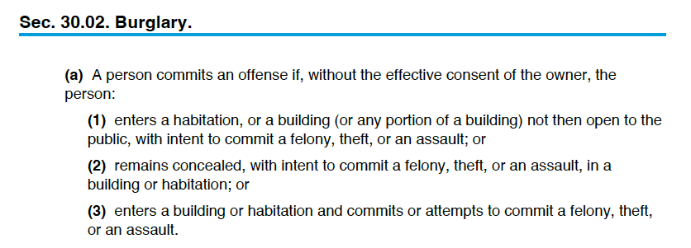
Notes:
Assume the DA identifies 30.02 (a)(1)as the prong she wishes to pursue, what issues will you need to research to understand whether it is possible to charge Glass with burglary?
Without effective consent of the owner
Entry
Habitation (building probably doesn’t apply)
Intent to commit a felony, theft, or assault.

Slide 7
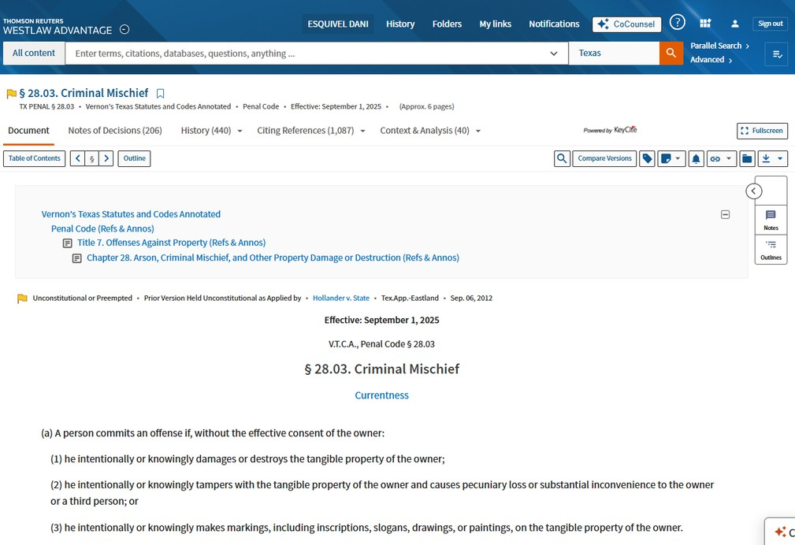
Anatomy of a Code:
The Citing References tab lists all sources--including cases, secondary sources, and more--that cite the statute.
The Context & Analysis tab is a curated list of non-case sources that may be helpful for gaining helpful context on the statute, including cross-references to related statutes and secondary sources.
The History tab includes information on earlier versions of the statute, including summaries of changes made by any amendments to the statute.
Westlaw
Notes of Decisions is a curated list of cases that interpret the statute’s language, organized by important sub-issues related to the statute.
The Table of Contents allows researchers to see the surrounding statutes that may be relevant to their research problem.
Currentness tells researchers when Westlaw last updated any changes to the statute made by the legislature into the database; typically, Westlaw updates very regularly, so Westlaw is usually current within the last week.
The Caption or Heading tells researchers where they’re located in the code--title, subtitle, chapter, and individual section--so they can assess that they’re in the appropriate place for their research issue.

Slide 8
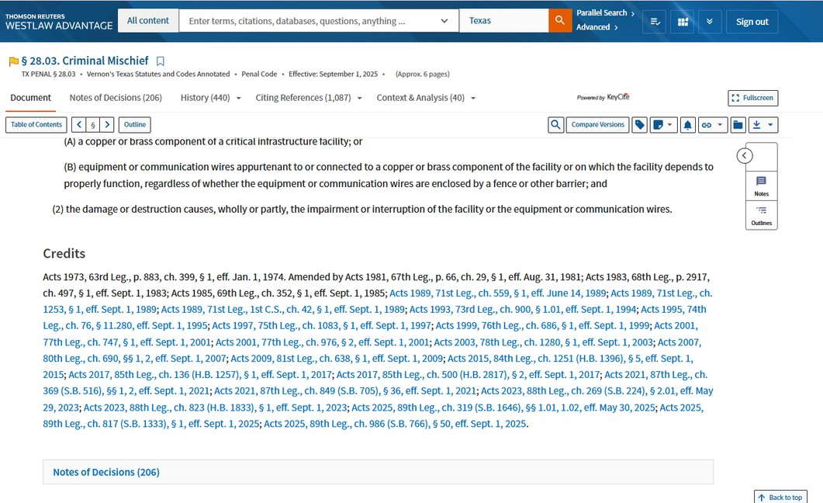
Anatomy of a Code:
Westlaw
The Statutory History Line lets researchers know when the statute was originally enacted and whether it’s ever been amended.

Slide 9
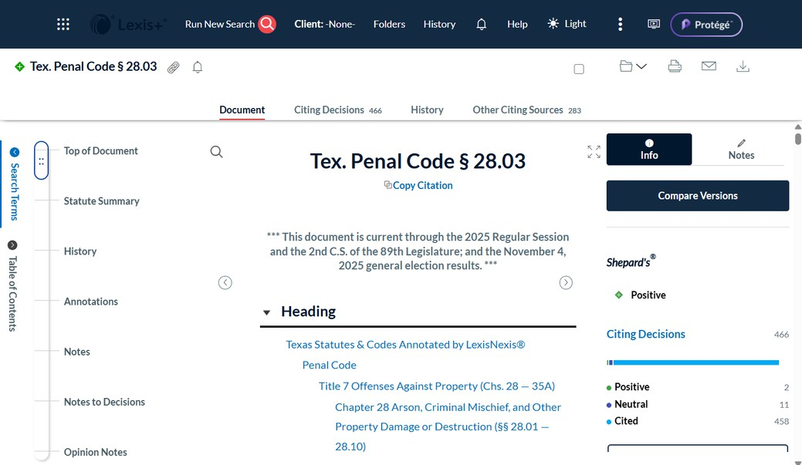
Anatomy of a Code:
History includes information on earlier versions of the statute, including summaries of changes made by any amendments to the statute.
Other Citing Sources lists all the non-case sources that cite the statute.
Lexis+
The Citing Decisions lists all the cases that cite the statute.
Currentness tells you when Lexis last updated any changes to the statute made by the legislature into the database; typically, Lexis updates very regularly, so Lexis is usually current within the last week.
The Caption or Heading tells researchers where they’re located in the code--title, subtitle, chapter, and individual section--so they can assess that they’re in the appropriate place for their research issue.
The Notes to Decisions is a curated list of cases that interpret the statute’s language, organized by important sub-issues related to the statute.

Slide 10
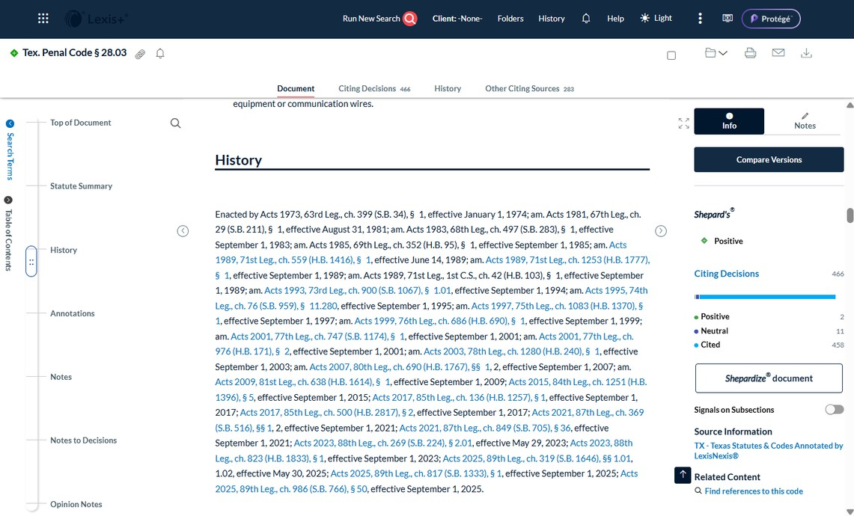
Anatomy of a Code:
Lexis+
The Statutory History Line lets researchers know when the statute was originally enacted and whether it’s ever been amended.

Slide 11
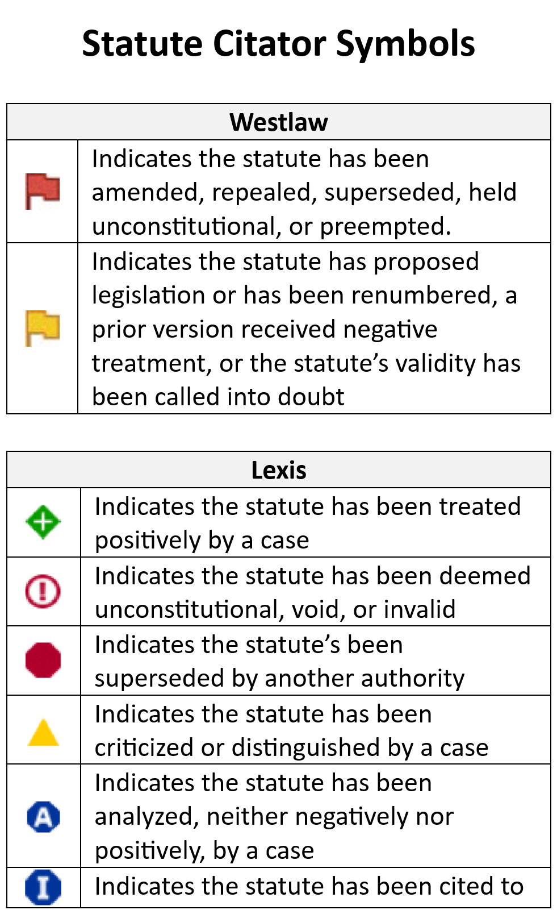
Determining if Statute is Good Law - Citator Symbols

Slide 12
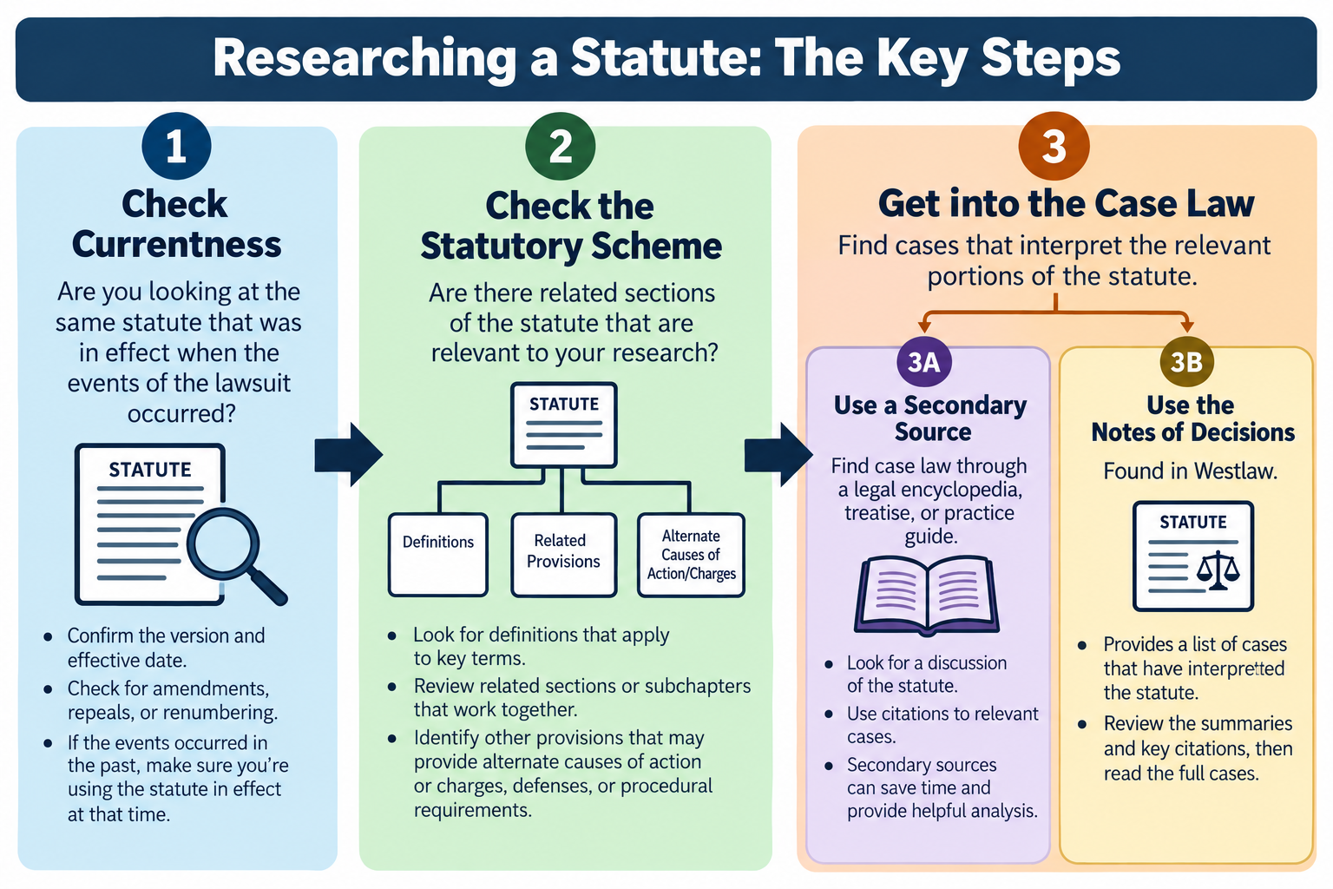
Research Exercise 3
Statutory Research
Once you find
ONE GOOD CASE you can find the whole universe of relevant case law within a jurisdiction.
Thursday

Slide 13
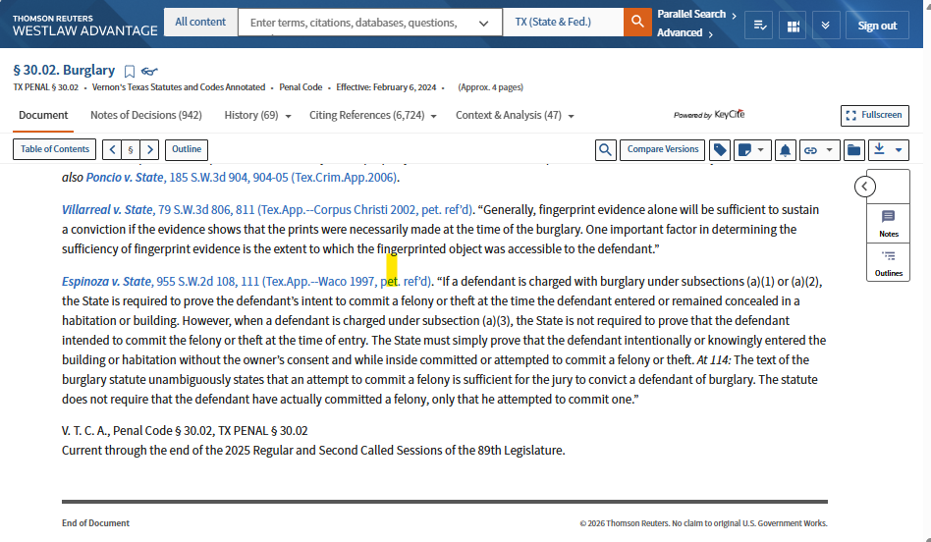
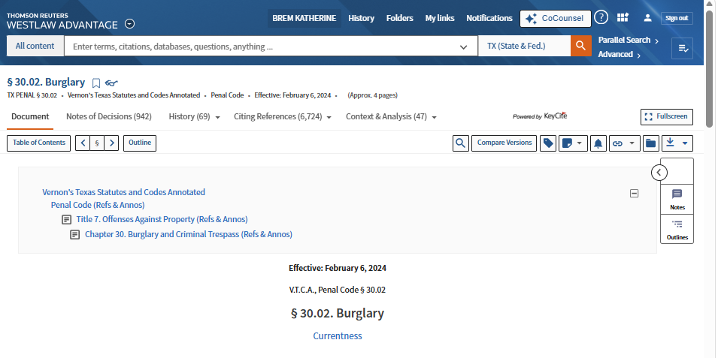

Slide 14
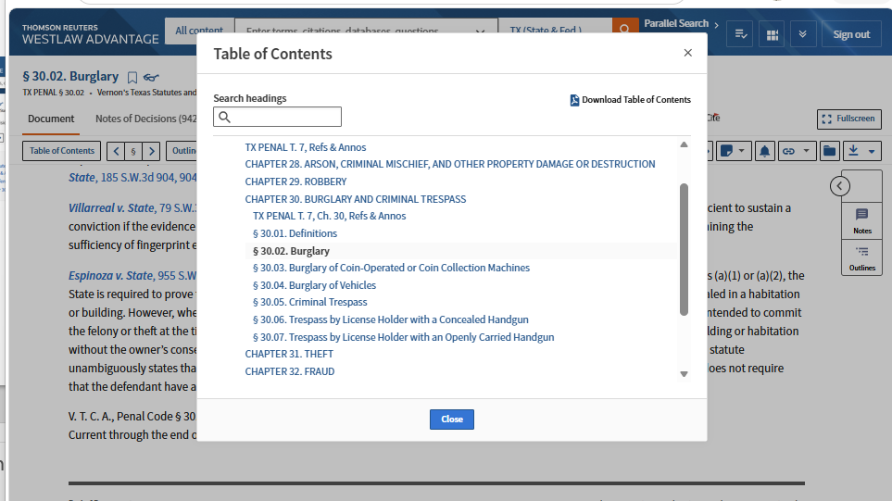

Slide 15
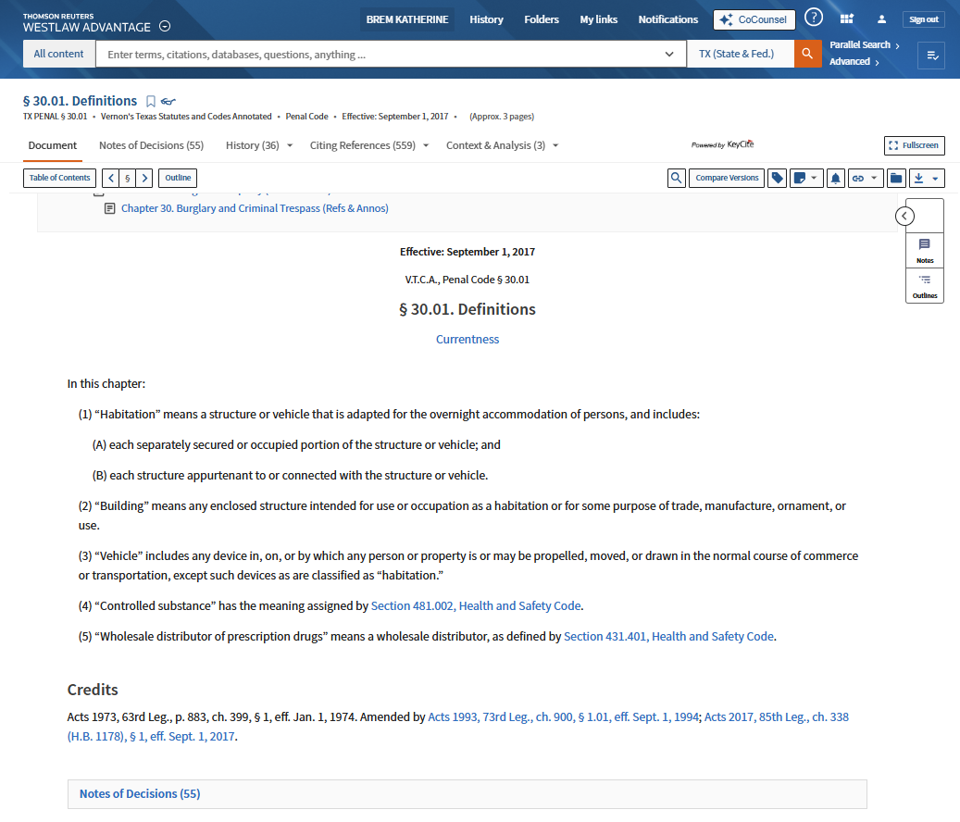


Slide 16
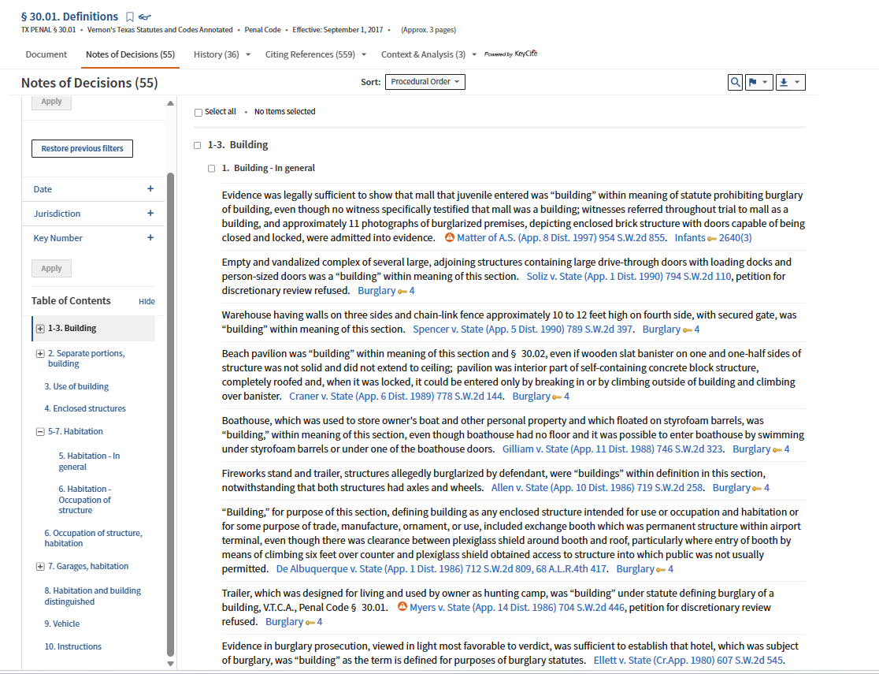

Slide 17
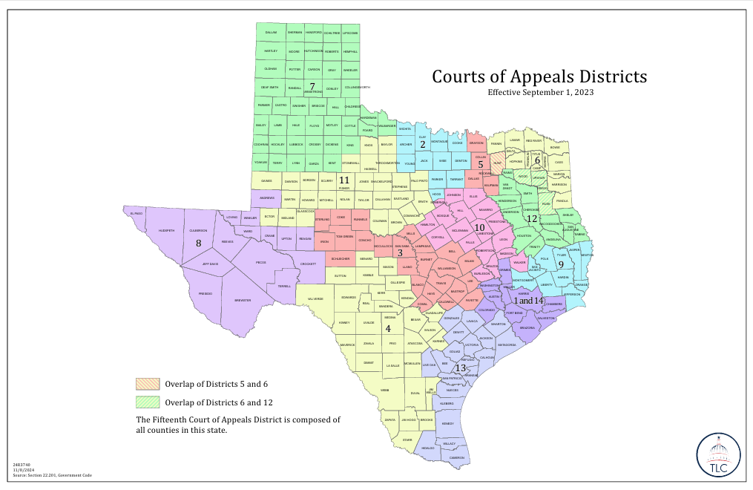
Austin Court of Appeals

Slide 18
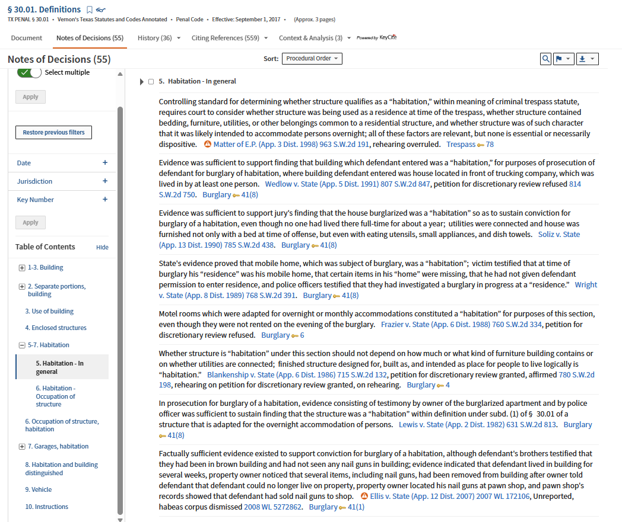

Slide 19
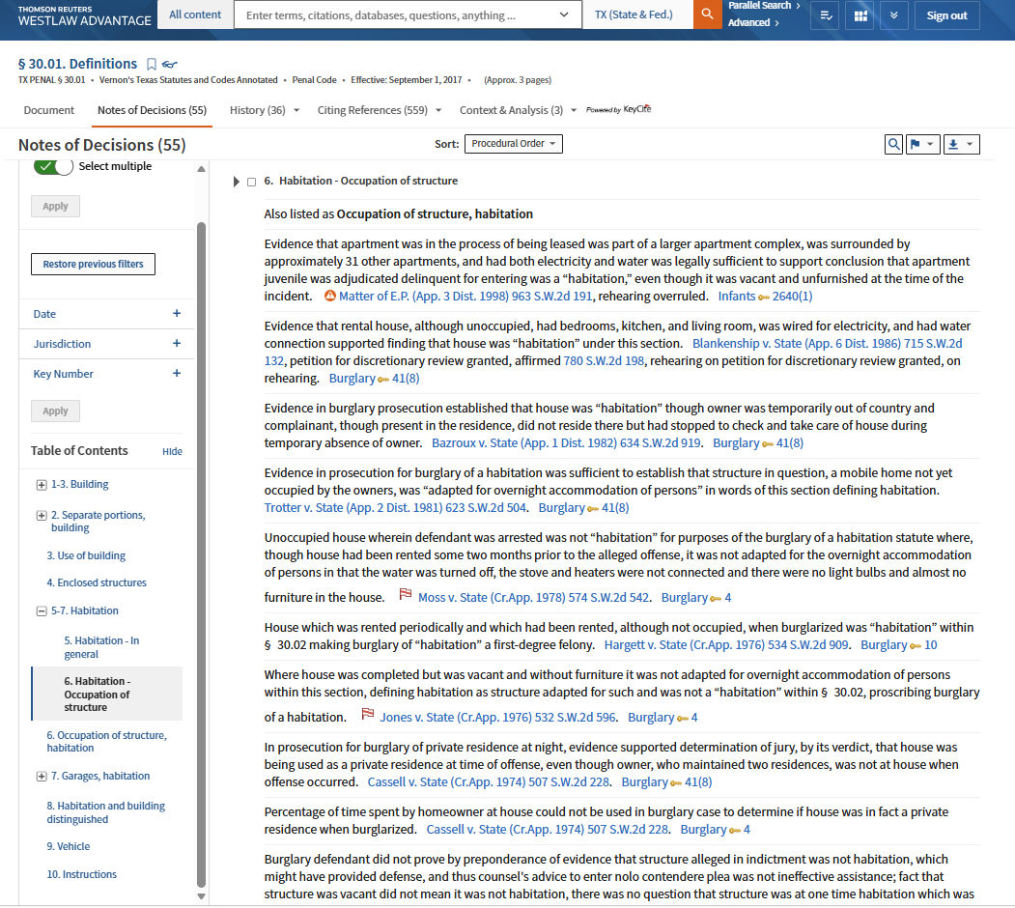

Slide 20
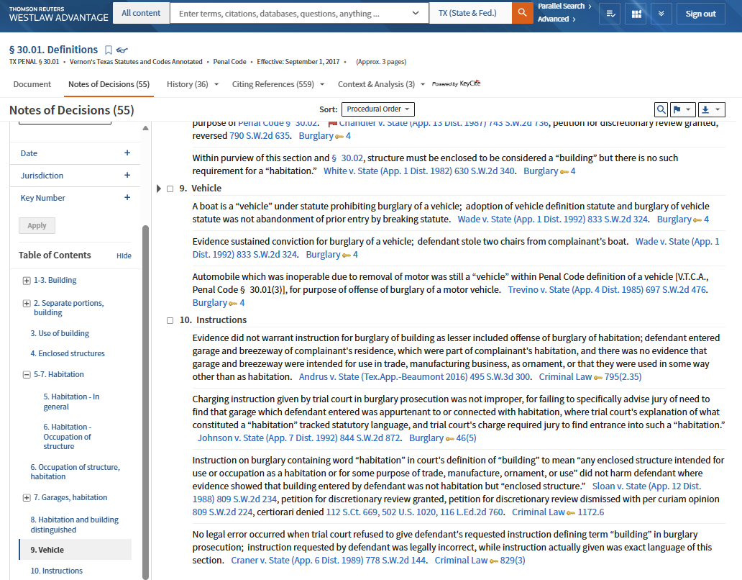

Slide 21
Homework
Complete Legal Research Modules 4.1-4.4 by CLASS TIME Thursday, 10/1
Complete Legal Research Modules 4.5 -4.9 by CLASS TIME Tuesday, 10/6
Graded Research Assessment, In-Class Thursday, 10/8

